Slide 1

Team Fast 3 Database Project
Matt Falkoski Ryu Muthui
Joon Jung

Slide 2
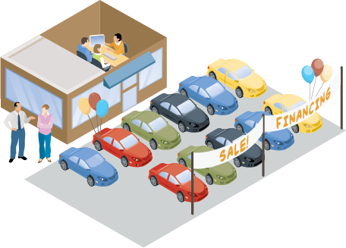
Car Dealership Database
What kind of database does this thing hold?
Table Overviews:
- Dealership info. - Vehicle Inventory - Employees - Customers - Parts - Parts Inventory - Services - Service Records - Sales

Slide 3
Design: Assumptions
Dealership provides car sales & services.
Dealership sells both new and used cars.
Dealership uses both new and used parts to fix cars.
Employees only can work at one physical location of dealership.
It is commission based job so only one salesperson associates on one vehicle sale.
Vehicle only purchases by one customer.
Customers can have vehicle even though they did not purchase vehicle from dealership.
Customers may own multiple vehicles.
Dealership may not get part that they ordered from vendor.
Some of services do not require using part (e.g. balancing tire, diagnosis engine, etc).
Database stores only WA state address in current design but set up for nation wide.

Slide 4
Design: Requirements and Goals
To Be able to Track the following efficiently:
Sales orders
Vehicle inventory
Service orders
Part inventory
Employee information
Customer information

Slide 5
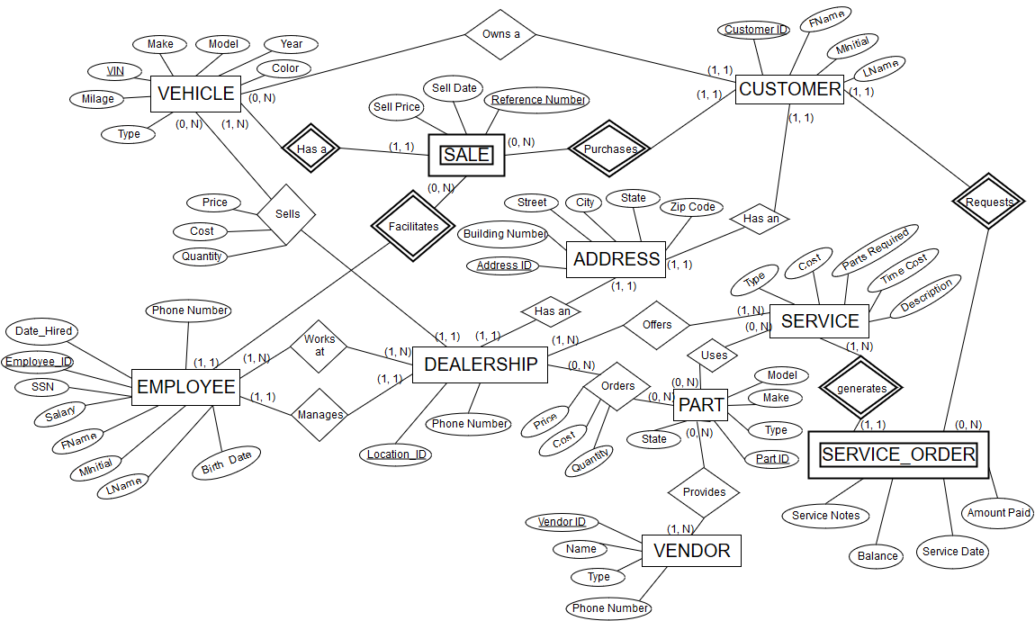
ER Diagram

Slide 6
Normalization
Dealership
1FD: Dealership_ID -> Address_ID
2FD: Dealership_ID -> Phone_number
3FD: Dealership_ID -> Manager_ID
Vehicle
1FD: VIN -> MAKE
2FD: VIN -> MODEL
3FD: VIN -> TYPE
4FD: VIN -> MILEAGE
5FD: VIN -> COLOR
6FD: VIN -> YEAR
Dealership_ID | Address_ID | Phone_number | Manager_ID
VIN | MAKE | MODEL | TYPE | MILEAGE | COLOR | YEAR

Slide 7



Tools and difficulties
Microsoft Azure
BitBucket
Draw.io
How to generate data

Slide 8
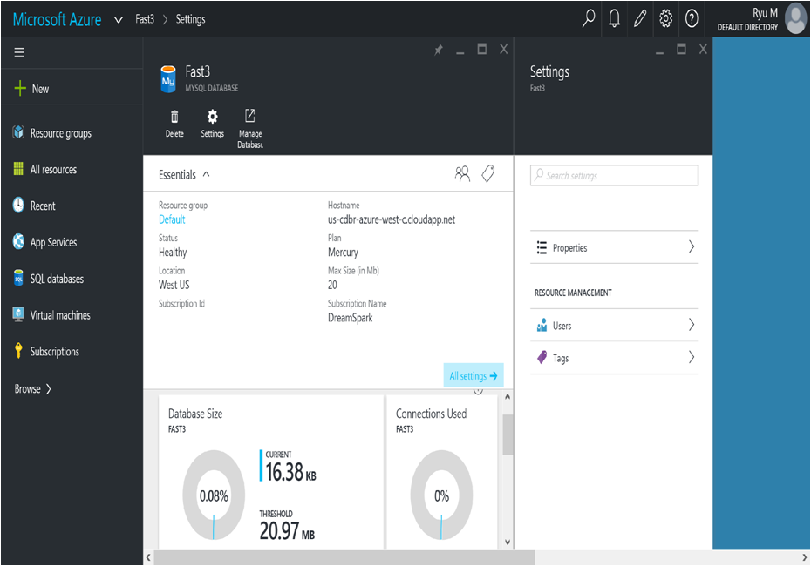

Slide 9
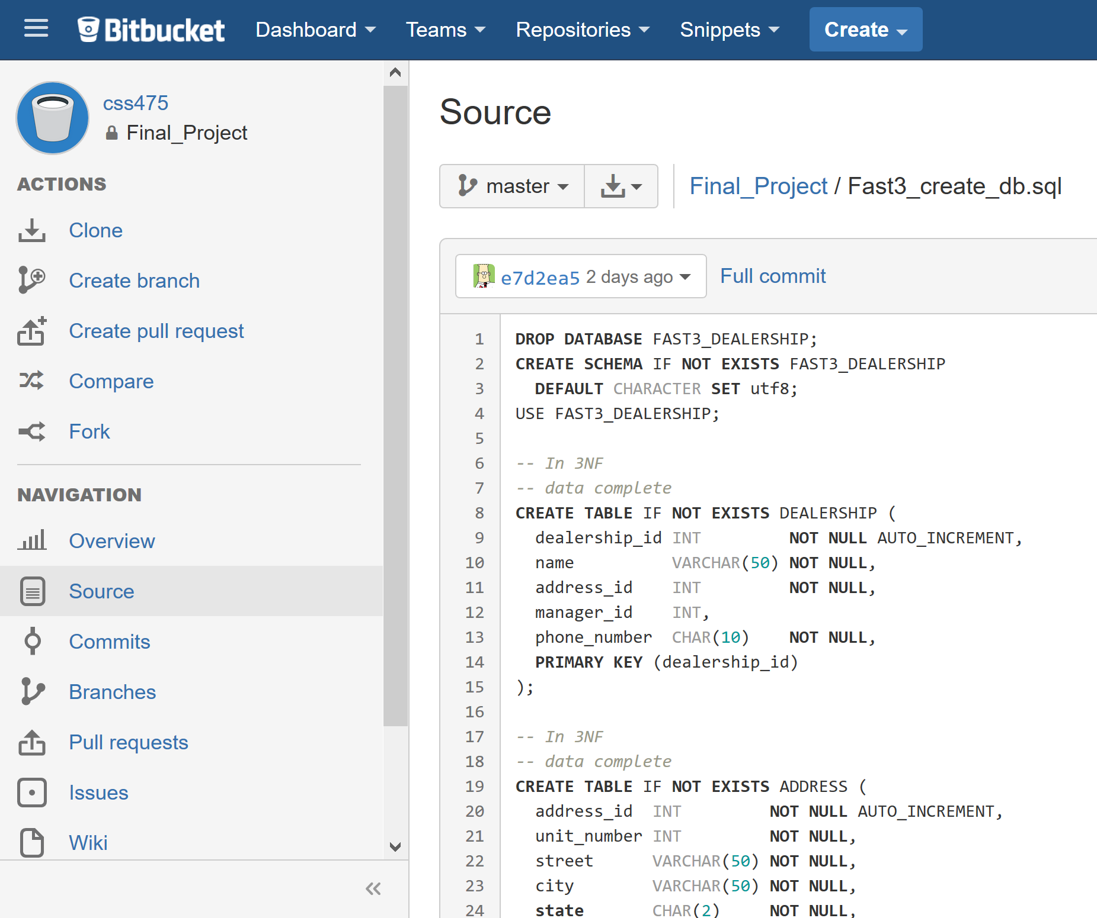

Slide 10
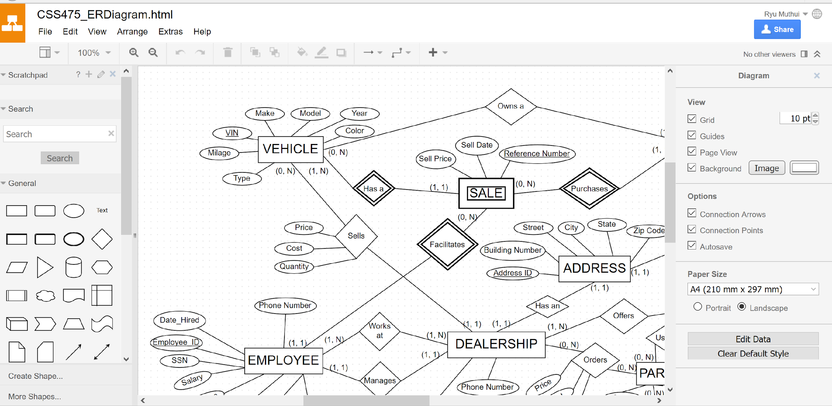

Slide 11
Evaluation of project
Time Spent:
Each member spent about 4~5hrs / week.
Things that went great:
Auto generation of data via scripts helped save much time.
Bit Bucket helped with code consolidation.
Things that went wrong:
Setting up server and permissions with Azure.
How would you do it differently if you have to do again?
Gathered more research to get domain knowledge.
If you had another week, what improvements would you focus on?
Testing the relations between tables and attributes.

Slide 12

Questions

